Slide 1
APPLICATION DEVELPOMENT THEORY ASSIGNMENT 2 GROUP MEMBERS
Sinethemba Poni 213276968
Stefano Ngantweni 216283132
Mthuthuzeli Magidigidi 210076763

Slide 2

Restaurant Stakeholders
Customers.
Busboys.
Waiter.
Manager.
Chef.

Slide 3
Requirements Engineering
Requirements engineering is the process of defining, documenting, and maintaining requirements in the engineering design process.
The system should allow a customer to place an order
The system must redirect the customer’s order to the kitchen staff
Once the order is placed the kitchen staff must confirm that the order has been received and is being prepared, by clicking on their tablet.
When the kitchen staff/chef is done preparing the order the chef must notify the system that the order is complete and prepared so that a waiter can pick up an order and deliver it to the customer
There should be three buttons at the table that will be used to determine the status of the table which will be linked to the system
Once the customer is finished enjoying his/her meal, the customer will use the table tablet to indicate he/she is done with the meal.

Slide 4
Requirements Engineering cont.…
The system should allow a customer to place an order
Economic feasibility – Achievable at no cost.
Operational feasibility – Straight forward and easy to use.
Elderly people with no knowledge of Technology might struggle to use the system. Therefore, a person who can assist those who are struggling to utilize the system might be needed.
Technical feasibility – Similar technology already exist, so it is a practical proposition.

Slide 5
Requirements Engineering cont.…
Feasibility Study
The system must redirect the customer’s order to the kitchen staff.
Economic feasibility – Cost effective.
Cost of guideline for customers on how to use the system.
Operational feasibility – Provides customers and managers with timely, pertinent, accurate and useful formatted information.
No training needed, can be utilized by intuition.
End users and management will easily adapt to change.
Technical feasibility – Currently don’t possess necessary technology.
Once the order is placed the kitchen staff must confirm that the order has been received and is being prepared, by clicking on their tablet.
Economic feasibility – Cost of hardware and development software (Software and the Tablet).
Possible with the given recourse constraints.

Slide 6
Software approach that is not suitable for the restaurant system.
The software development approach that is not suitable for our project is the waterfall model because the waterfall approach is inflexible. This means that it does not accommodate change after the process is underway. A phase needs to be complete before moving on to the next phase.
This model is only appropriate when the requirements are well understood. Changes during the design process also need to be minimal. Since our project requirements are not well defined and our project is going to require constant change, hence we have therefore concluded that the waterfall approach is not suitable for our project.

Slide 7
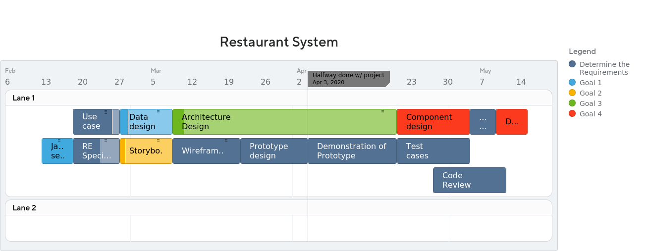
Roadmap

Slide 8
